Slide 1
Capstone Project
Harnessing NLP to Detect Stress
in
Social Media
Early Intervention for Mental Wellbeing Presenter: Jimmy Chong

Slide 2
Agenda
Bio
Project Context & Business Problem
Business & Data Science Considerations
Data Overview
Data Exploration
Data Split
Data Overview
Deliver
Summary, Conclusions & Next Steps
Appendix

Slide 3
Bio
Education
Professional experience
Data science learnings and experience
Relevance to the project

Slide 4

Project Context & Business Problem
Industry: NLP and Mental Health
Problem: Detecting stress in social media text
Interest: Growing mental health concerns, potential for early intervention, NLP advancements
Previous Work:
NLP techniques: Sentiment analysis, topic modeling, machine learning
Domains: Twitter, Reddit, general datasets
Key findings: Promising accuracy, varying generalizability and robustness
Limitations: Reliance on labeled datasets, potential for bias
Contribution: Exploring LSTM networks, addressing limitations
Notes:
Industry or Domain:
Natural Language Processing (NLP)
Mental Health
Problem Area:
Detecting stress in social media text
Why is this area interesting?
Growing prevalence of mental health issues
Importance of early intervention
Potential for using NLP to analyze large amounts of data
Limited research on stress detection in social media
Previous Work in this Area:
Overview of existing research:
Previous studies have explored various NLP techniques, such as sentiment analysis, topic modeling, and machine learning algorithms, to detect stress in social media text.
Some studies have focused on specific domains, such as Twitter or Reddit, while others have used more general datasets.
Key findings and limitations:
Many studies have reported promising results in terms of accuracy, but the generalizability and robustness of the models can vary.
Some limitations include the reliance on labeled datasets, which can be challenging to obtain, and the potential for bias in the data.
Building upon previous work:
This research aims to contribute to the field by exploring advanced NLP techniques, such as LSTM networks, and addressing the limitations of previous studies.

Slide 5
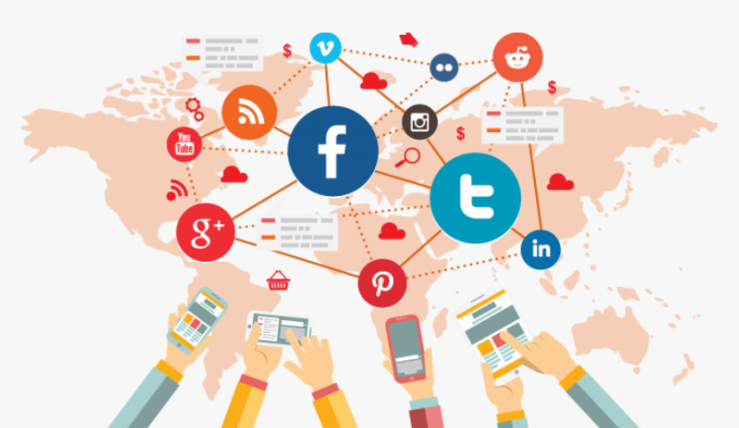
Business & Data Science Considerations
Stakeholders: Mental health professionals, social media platforms, technology companies, individuals
Business Question: Can we accurately detect stress in social media text?
Business Value: Early intervention, improved user experience, new market opportunities
Data:
Question: Can we extract effective features for stress prediction?
Required: Social media text, stress labels, metadata
Sourced: Reddit, Twitter, Kaggle
Generation: User-generated content
Future Sourcing: Continued access to APIs, exploring other platforms
Notes:
Business Aspects
a) Stakeholders:
Mental health professionals
Social media platforms
Technology companies
Individuals struggling with mental health
b) Business Question:
Can we accurately detect stress in social media text using NLP techniques?
c) Business Value:
Early intervention and improved mental health outcomes
Enhanced user experience on social media platforms
Opportunities for new products and services in the mental health technology space
Data Science Aspects
a) Data Question:
Can we effectively extract features from social media text that accurately predict stress levels?
b) Data Required:
Social media text data (e.g., Reddit, Twitter)
Stress labels (indicating whether the text is related to stress)
Metadata (e.g., user demographics, time of posting)
c) Data Sourced:
Reddit and Twitter APIs
Kaggle dataset
d) Data Source, Description, Volume and Quality:
Reddit and Twitter: User-generated text posts, varying lengths and topics, potential for bias and noise.
Kaggle dataset: Preprocessed data with stress labels, volume and quality may vary depending on the specific dataset.
e) How is the data generated?
User-generated content on social media platforms
f) How it can be sourced in the future:
Continued access to Reddit and Twitter APIs
Exploring other social media platforms or collecting data through partnerships

Slide 6

Data Overview (1)
Stress Detection from Social Media Articles
Source: Kaggle Dataset
Objective: Develop a more accurate and efficient NLP-based approach to automatically detect stress in social media text, enabling early intervention and improved mental health support.

Slide 7

Data Overview (2)
Stress Detection from Social Media Articles
Datasets:
Constructed four datasets using text articles from Reddit and Twitter.
Each article is labeled with a class value of '0' (Stress Negative) or '1' (Stress Positive).
Dataset Descriptions:
Reddit Combi: This dataset combines title and body text from stress and non-stress related subreddits.
Reddit Title: This dataset consists of titles from stress and non-stress related subreddits.
Twitter Full: This dataset contains stress and non-stress related tweets.
Twitter Non-Advert: This dataset is a denoised version of Twitter Full, removing potential advertisements.

Slide 8

Data Exploration (1)
Understanding the Data
Explored the data using Python libraries like pandas to understand the number of rows, column names, and data types.
Examined the first few rows of each Data Frame to get a sense of the content and labels.
Checked for missing values and handled them by dropping rows with missing entries (dropna).
Preprocessed the data:
Dropped unnecessary columns (Reddit Combi).
Cleaned hashtags in Twitter data using regular expressions.
Concatenated all preprocessed Data Frames into a single one.
Analyzed the data distribution:
Visualized the distribution of stress labels using a bar chart.
Examined the distribution of text length for stress and non-stress articles using a histogram.
Generated word clouds to visualize frequently used words in stress and non-stress articles.

Slide 9

Data Exploration (2)
Understanding the Data
Number of Rows and Columns:
Reddit Combi: 3123 rows, 4 columns
Reddit Title: 5556 rows, 2 columns
Twitter Full: 8900 rows, 3 columns
Twitter Non-Advert: 2051 rows, 2 columns
Data Types:
title: object (text)
label: int64/boolean (stress label)
body: object (text) (only in Reddit Combi)
hashtags: object (text) (only in Twitter Full)
Missing Values:
Handled missing values by dropping rows with missing entries in body column.
Data Preprocessing:
Dropped unnecessary columns in Reddit Combi.
Cleaned hashtags in Twitter Full using regular expressions.
Concatenated all datasets into a single DataFrame.

Slide 10
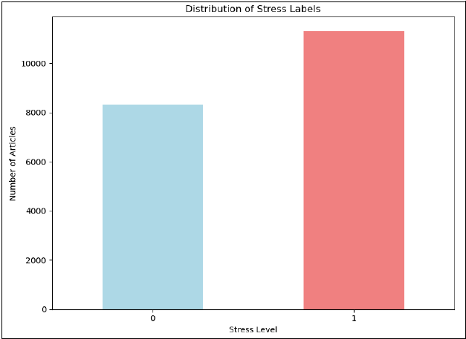
Data Exploration (3)
Frequency of Stressful and Non-Stressful Posts
Key Notes:
Class imbalance: More non-stressful articles than stressful ones.
Impact on modeling: Require techniques like class weighting or oversampling.
Further investigation: Explore factors contributing to imbalance (e.g., labeling difficulty, data collection bias).
Notes:
Description:
This bar chart illustrates the distribution of stress labels within the dataset. It shows a clear class imbalance, with a significantly higher number of non-stressful posts compared to stressful posts.
Key Takeaways:
The dataset is imbalanced, with a higher proportion of non-stressful articles.
This imbalance can impact model performance and may require techniques like class weighting or oversampling to address.
Further investigation into the factors contributing to this imbalance could provide valuable insights into the data collection process and the potential biases present in the dataset.
Additional Notes:
Class Imbalance: The imbalance in stress labels might be due to various factors, such as the difficulty of accurately labeling stress-related posts or the overall prevalence of stress in the target population.
Data Collection Bias: The data collection process may have introduced biases, such as a focus on certain types of stress-related content or a lack of representation for certain demographic groups.
Impact on Modeling: The class imbalance can affect model performance, as models might be biased towards predicting the majority class. Techniques like class weighting or oversampling can help mitigate this issue.

Slide 11
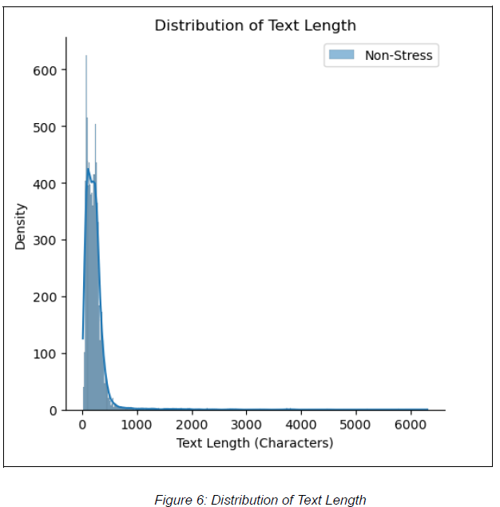
Data Exploration (4)
Distribution of Text Length
Key Notes:
Skewed distribution: Most posts are relatively short.
Overlapping distributions: Text length alone may not be a strong predictor.
Non-stressful posts: Slightly longer on average
Notes:
Description:
This histogram shows the distribution of text lengths for both stressful and non-stressful posts.
Key Takeaways:
Skewness: The distributions are skewed to the right, indicating that a majority of posts have relatively short lengths, while there are a few longer posts.
Overlapping: There is some overlap between the distributions, suggesting that text length alone may not be a strong predictor of stress.
Non-Stressful Posts: The distribution of non-stressful posts is slightly wider and has a heavier tail on the right side, indicating that they tend to be slightly longer than stressful posts.
Implications:
Feature Engineering: While text length might not be a strong predictor on its own, it could be combined with other features or used as a weighting factor in modeling.
Model Selection: The skewed distribution and overlap might suggest that models that can handle long sequences, such as LSTM networks, could be more suitable for this task.

Slide 12
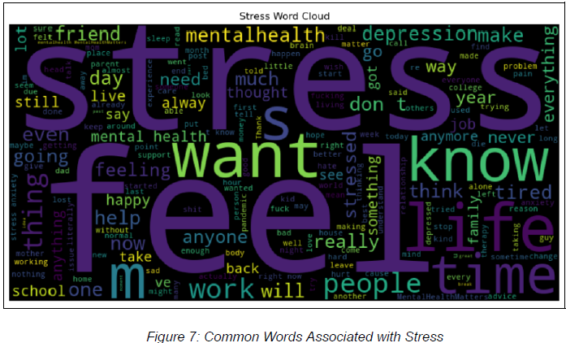
Data Exploration (5)
Common Words Associated with Stress
Key Notes:
Negative emotions: "stress," "depressed," "sad," "anxious"
Life challenges: "work," "school," "relationships," "personal problems"
Seeking help: "help," "support," "therapy"
Notes:
Description:
This word cloud visualizes the most frequently used words in the text posts labeled as stressful. The size of each word represents its relative frequency within the corpus.
Key Takeaways:
Negative Emotions: Words like "stress," "depressed," "sad," and "anxious" are prominently featured, highlighting the prevalence of negative emotions in the text.
Life Challenges: Terms related to work, school, relationships, and personal problems are frequently mentioned, suggesting that these factors contribute to stress.
Seeking Help: Words like "help," "support," and "therapy" indicate that individuals experiencing stress may be actively seeking assistance.
Implications:
Understanding Stress Triggers: The word cloud provides insights into the common themes and experiences associated with stress, which can inform intervention strategies and support resources.
Targeted Interventions: By identifying specific words or phrases related to stress, we can develop more targeted interventions and support messages.
Content Analysis: The word cloud can be used for content analysis to automatically identify potentially stressful posts and flag them for further review.

Slide 13
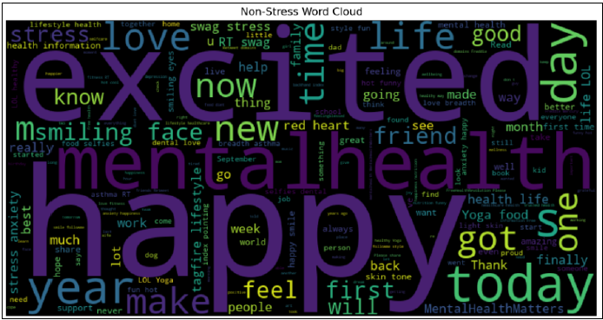
Data Exploration (6)
Common Words Associated with Non-Stress
Key Notes:
Positive emotions: "happy," "love," "good," "excited"
Everyday life: "daily activities," "hobbies," "social interactions"
Gratitude and appreciation: "thankful," "grateful," "proud"
Notes:
Description:
This word cloud visualizes the most frequently used words in the text posts labeled as non-stressful. The size of each word represents its relative frequency within the corpus.
Key Takeaways:
Positive Emotions: Words like "happy," "love," "good," and "excited" are prominently featured, highlighting the prevalence of positive emotions in the text.
Everyday Life: Terms related to daily activities, hobbies, and social interactions are frequently mentioned, suggesting a focus on positive aspects of life.
Gratitude and Appreciation: Words like "thankful," "grateful," and "proud" indicate a sense of contentment and appreciation.
Implications:
Understanding Non-Stress Patterns: The word cloud provides insights into the linguistic patterns associated with non-stressful posts, which can help identify factors contributing to positive mental health.
Contrasting with Stressful Posts: Comparing this word cloud with the stress word cloud can highlight the differences in language usage between the two categories.
Content Analysis: The word cloud can be used for content analysis to automatically identify potentially positive posts and provide targeted support or resources.

Slide 14
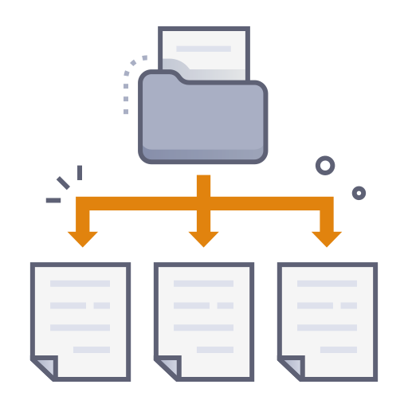
Data Split
Data Preparation for Modeling
Split data into features (title) and target (stress label).
Split data into training (80%) and testing (20%) sets.

Slide 15

Data Overview
Key Findings:
Class imbalance: More non-stressful articles than stressful ones.
Overlapping text length distributions: Text length alone may not be a strong predictor of stress.
Distinct word patterns: Different words are frequently used in stress and non-stress articles.
Notes:
Source: Kaggle Dataset
Objective: Develop a more accurate and efficient NLP-based approach to automatically detect stress in social media text, enabling early intervention and improved mental health support.
Datasets:
We constructed four high-quality datasets using text articles from Reddit and Twitter.
Each article is labeled with a class value of '0' (Stress Negative) or '1' (Stress Positive).
Annotations were done using an automated DNN-based strategy.
Dataset Descriptions:
Reddit Combi: This dataset combines title and body text from stress and non-stress related subreddits.
Reddit Title: This dataset consists of titles from stress and non-stress related subreddits.
Twitter Full: This dataset contains stress and non-stress related tweets.
Twitter Non-Advert: This dataset is a denoised version of Twitter Full, removing potential advertisements.
Data Exploration:
We explored the data using Python libraries like pandas to understand the number of rows, column names, and data types.
We examined the first few rows of each DataFrame to get a sense of the content and labels.
We checked for missing values and handled them by dropping rows with missing entries (dropna).
We preprocessed the data:
Dropped unnecessary columns (Reddit Combi).
Cleaned hashtags in Twitter data using regular expressions.
Concatenated all preprocessed DataFrames into a single one.
We analyzed the data distribution:
Visualized the distribution of stress labels using a bar chart.
Examined the distribution of text length for stress and non-stress articles using a histogram.
Generated word clouds to visualize frequently used words in stress and non-stress articles.
Data Split:
We split the data into features (title) and target (stress label).
We further split the data into training (80%) and testing (20%) sets for model evaluation.

Slide 16
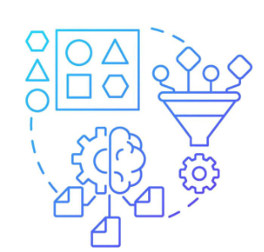
Deliver (1)
Feature Engineering
Key Features:
Text data (primary feature)
Captures sentiment, emotions, and vocabulary
Business Significance:
Text features are crucial for understanding the linguistic cues associated with stress.
Effective feature engineering can improve model performance and interpretability.
Techniques:
Text Cleaning:
Removes irrelevant information (punctuation, stop words, hashtags).
Text Normalization:
Lowercases text for consistency.
TF-IDF Vectorization:
Converts text into numerical features representing word importance.
Notes:
What are the most important features and what is the business significance?
Text data is the primary feature used in this model.
Text features can capture the sentiment, emotions, and vocabulary used in social media posts, which can be indicative of stress levels.
Feature engineering focuses on pre-processing the text data for machine learning models. This includes steps like:
Removing irrelevant information (e.g., punctuation, stop words)
Lowercasing text
Converting text to numerical representations (e.g., using TF-IDF)
Examples of Feature Engineering Techniques Used:
Text Cleaning: Removing punctuation, stop words, and hashtags.
Text Normalization: Lowercasing text for consistency.
TF-IDF Vectorization: Converting text into numerical features that represent the importance of words in a document.

Slide 17

Deliver (2)
Machine Models Used
LinearSVC: This is a linear support vector classifier used in the initial model. It is a good choice for text classification tasks due to its simplicity and efficiency.
LSTM (Long Short-Term Memory): This is a recurrent neural network architecture used in the later model. LSTMs are well-suited for sequential data like text, as they can capture long-term dependencies between words.
Notes:
What are the most important features and what is the business significance?
Text data is the primary feature used in this model.
Text features can capture the sentiment, emotions, and vocabulary used in social media posts, which can be indicative of stress levels.
Feature engineering focuses on pre-processing the text data for machine learning models. This includes steps like:
Removing irrelevant information (e.g., punctuation, stop words)
Lowercasing text
Converting text to numerical representations (e.g., using TF-IDF)
Examples of Feature Engineering Techniques Used:
Text Cleaning: Removing punctuation, stop words, and hashtags.
Text Normalization: Lowercasing text for consistency.
TF-IDF Vectorization: Converting text into numerical features that represent the importance of words in a document.

Slide 18
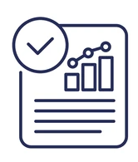
Deliver (3)
Evaluation Metrics
Accuracy: Measures the proportion of correct predictions made by the model.
Confusion Matrix: Visualizes the number of correct and incorrect predictions for each class (stressful vs. non-stressful).
Classification Report: Provides detailed information about the model's performance, including precision, recall, and F1-score for each class.
ROC AUC Score: This metric is used for imbalanced datasets and measures the model's ability to distinguish between classes (AUC-ROC score closer to 1 indicates better performance).

Slide 19
Deliver (4)
Evaluation Metrics - Accuracy

Slide 20
Deliver (5)
Evaluation Metrics - Confusion Matrix

Slide 21
Deliver (6)
Evaluation Metrics - Classification Report

Slide 22
Deliver (7)
Evaluation Metrics - ROC AUC Score

Slide 23
Summary, Conclusions & Next Steps
Summary
A brief recap of the presentation
Conclusions
What has been achieved?
Next steps
How can this project be developed further and implemented in real life?

Slide 24
Appendices

Slide 25
References
Data Source: https://www.kaggle.com/datasets/mexwell/stress-detection-from-social-media-articles
Source Code:
https://github.com/jimmychong1983/SocialMediaStressDetection
Notes:
Source: Kaggle Dataset
Objective: Develop a more accurate and efficient NLP-based approach to automatically detect stress in social media text, enabling early intervention and improved mental health support.
Datasets:
We constructed four high-quality datasets using text articles from Reddit and Twitter.
Each article is labeled with a class value of '0' (Stress Negative) or '1' (Stress Positive).
Annotations were done using an automated DNN-based strategy.
Dataset Descriptions:
Reddit Combi: This dataset combines title and body text from stress and non-stress related subreddits.
Reddit Title: This dataset consists of titles from stress and non-stress related subreddits.
Twitter Full: This dataset contains stress and non-stress related tweets.
Twitter Non-Advert: This dataset is a denoised version of Twitter Full, removing potential advertisements.
Data Exploration:
We explored the data using Python libraries like pandas to understand the number of rows, column names, and data types.
We examined the first few rows of each DataFrame to get a sense of the content and labels.
We checked for missing values and handled them by dropping rows with missing entries (dropna).
We preprocessed the data:
Dropped unnecessary columns (Reddit Combi).
Cleaned hashtags in Twitter data using regular expressions.
Concatenated all preprocessed DataFrames into a single one.
We analyzed the data distribution:
Visualized the distribution of stress labels using a bar chart.
Examined the distribution of text length for stress and non-stress articles using a histogram.
Generated word clouds to visualize frequently used words in stress and non-stress articles.
Data Split:
We split the data into features (title) and target (stress label).
We further split the data into training (80%) and testing (20%) sets for model evaluation.

Slide 26
Questions

Slide 27
Thank you
End of Presentation

Slide 28
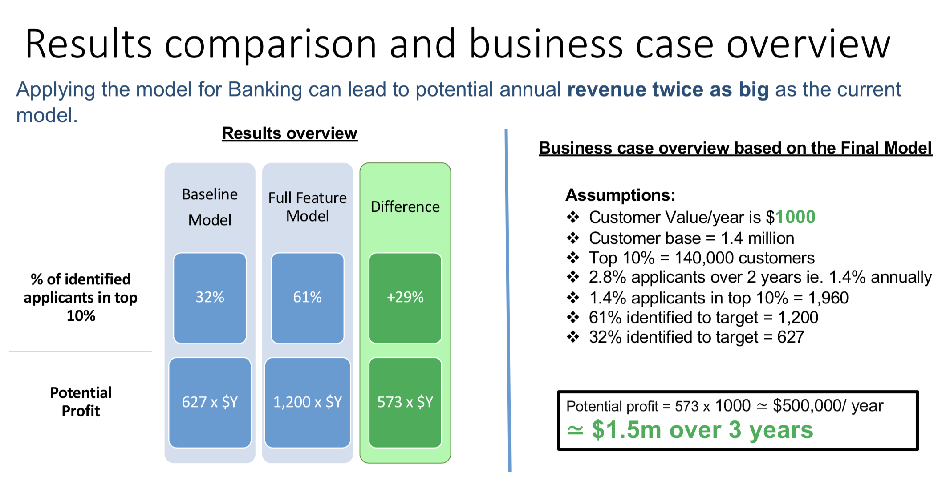
Case study: Home loans marketing

Slide 29

2024

Slide 30
Data Science and AI
Capstone Project
Harnessing NLP to Detect Stress in Social Media
Early Intervention for Mental Wellbeing

Slide 31
Capstone Project
You are required to define, design and deliver a data science project towards the end of the course.
Project milestones:
<date tbd> : present 3 ideas for the project
<date tbd> : decide on one option
<date tbd> : collect data
<date tbd> : present initial findings
<date tbd> : present an update
<date tbd> : Dry run of final presentation
<date tbd> : Present final report

Slide 32
What to present
Business perspective
Business insights uncovered
Business scenarios for how the project can be deployed and used
Approach for estimating business value
Technical perspective
Techniques used
Pipeline
Model validation results

Slide 33
Project evaluation criteria
The project is evaluated on the quality, clarity and completeness of the definition, design and delivery of the project.
Definition (20%)
Business context, stakeholders and value
Data description, sources, quality
Design (30%)
Data exploration, analysis and visualisation
Documentation: text document, presentation and Notebook
The project planning, effort allocation and next steps
Delivery (50%)
Feature Engineering
Creation of an effective reproducible pipeline
Machine Learning model algorithms and accuracy
Overall end-to-end solution
Delivery of the presentation, poise and audience engagement

Slide 34
Questions?

Slide 35
Presentation Skeleton

Slide 36
